Slide 1

Open Source Open Mind
TW Xi’an

Slide 2


Slide 3
History
Unix
1970
1979~1984
OSS(OSI)
1998
GNU/Linux
1990
BSD(CSRF)
GNU(FSF)

Slide 4



Slide 5

What is OSS
Redistribution
Availability of source code
Compliant license
No discrimination

Slide 6
3C of OSS
Code
Collaboration
Community

Slide 7
OSS License
Close-Source support
Non-Close-Source support

Slide 8
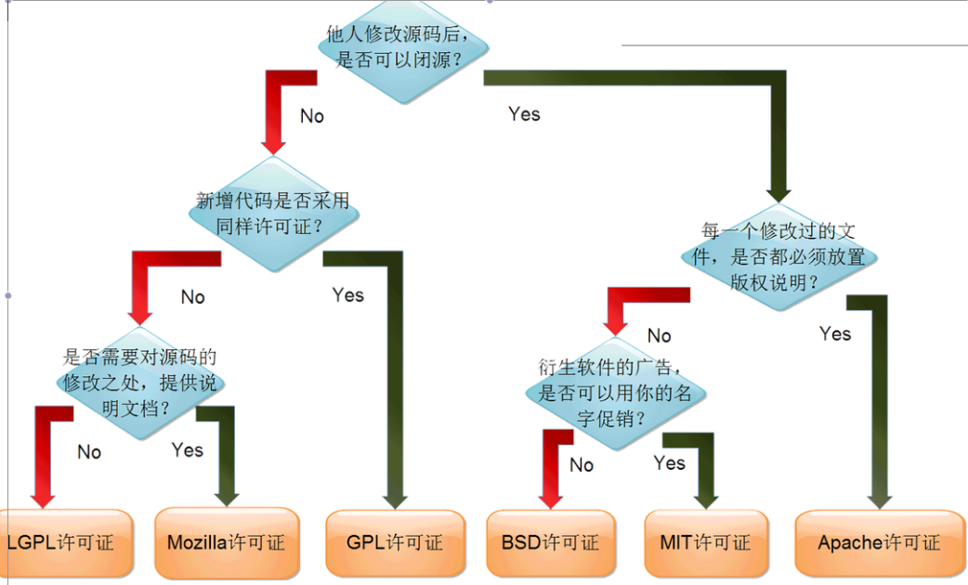
Open Source License

Slide 9
MySQL (GPL/MySQL AB)
JBOSS (LGPL)
Android (APL)
JQuery (MIT)
CruiseControl (BSD-style License)

Slide 10
OSS Hosting
Github
Gitorious
SourceForge
Google code project

Slide 11
Community
Wiki
Blogs
Mailing lists
IRC channel

Slide 12
Tooling
Version Control
Building/Packaging
Bug Tracking

Slide 13
What we are committing
http://opensource.thoughtworks.com/

Slide 14
Benefit
Extending knowledge
Improving experience
Enjoying influence

Slide 15
How to Profit
Multiple Version
Technical Support
Documentation

Slide 16
Just Do It !

